Slide 1
Professional Development Day August 19, 2011

Slide 2
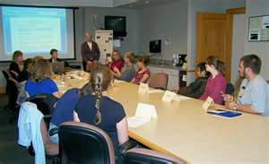
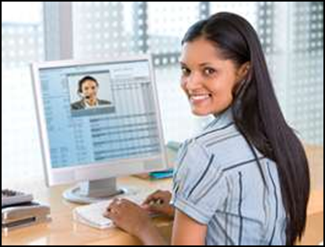
Why Use CCC Confer?
Traditional Meetings | CCC Confer Meetings
Travel time & commute | From anywhere
Associated expenses | No cost
Face to face | On your phone & computer
Share, interact, teach, learn | Share, interact, teach, learn
Leave the meeting… | Record the meeting & review later

Slide 3
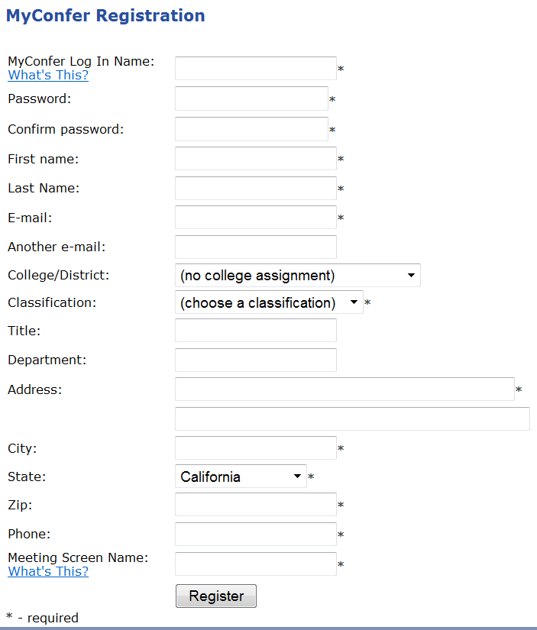
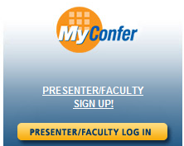
Register

Slide 4
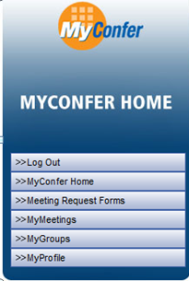
Using MyConfer

Slide 5
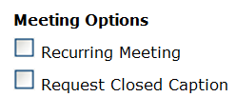
Scheduling Options
Request Form Field:
Closed Caption offered for for:
Recurring Meeting offered for:

Slide 6
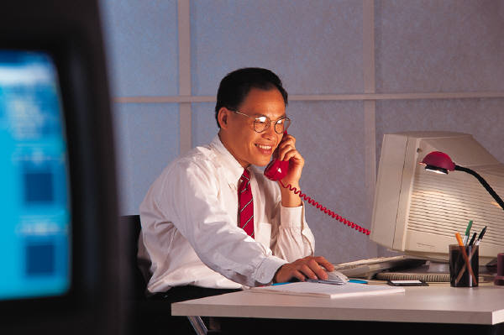
Communication Tools
Toll-free conference
VOIP
Text chat

Slide 7
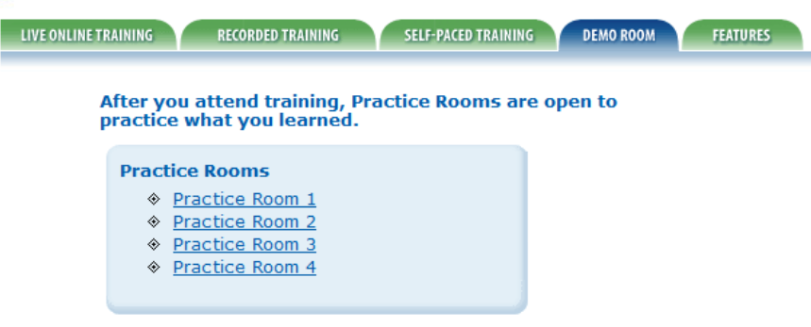
Everybody Log in!

Slide 8
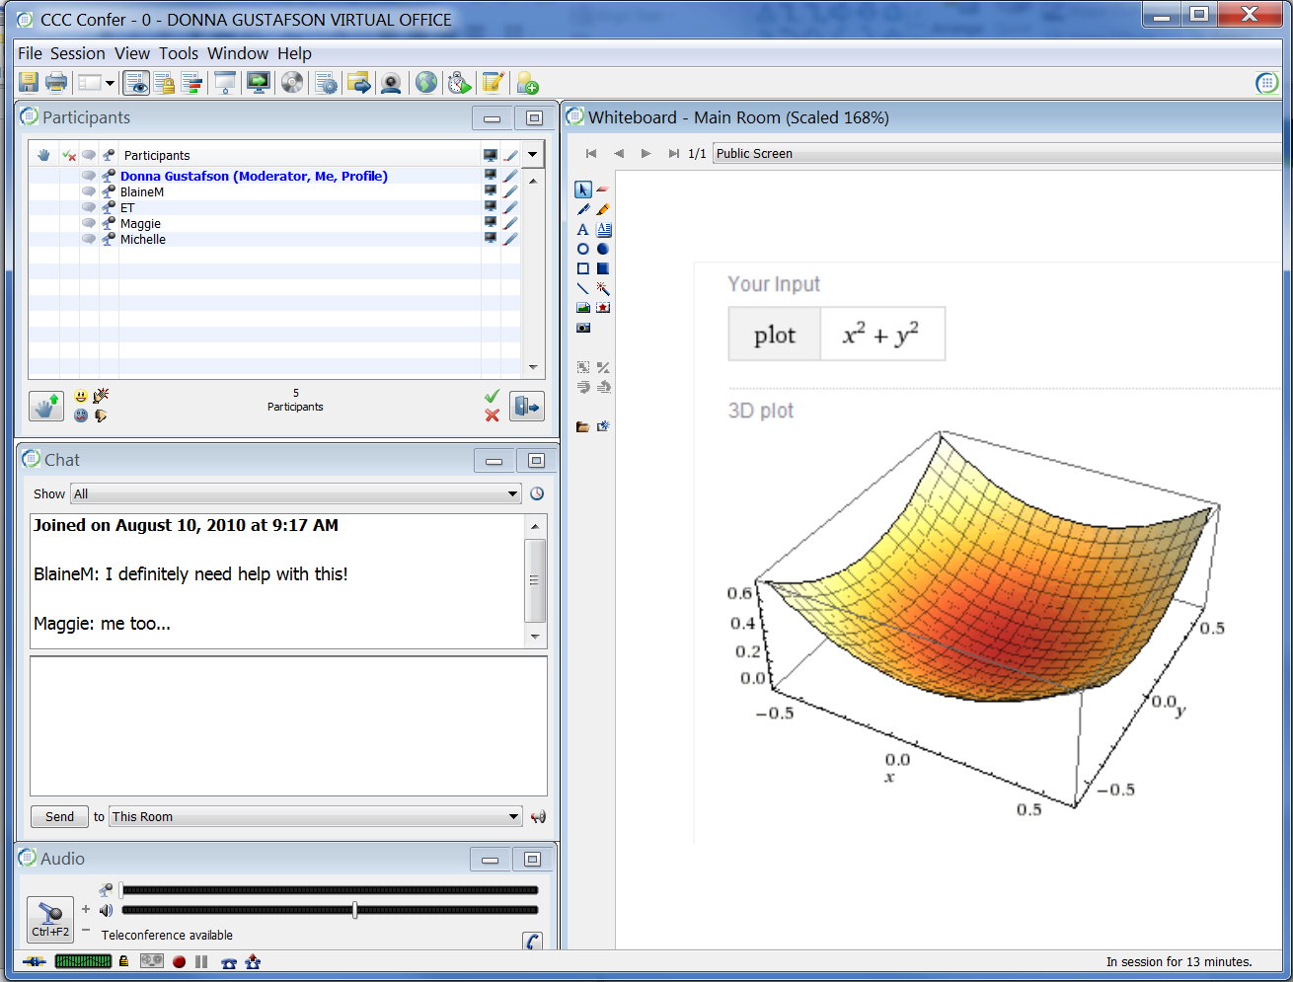
This is the Room
Text & Icon Menus
Whiteboard Tools
Participants & Feature Permissions
Whiteboard & Content Display
Text Chat
VOIP Controls
Recording Controls

Slide 9
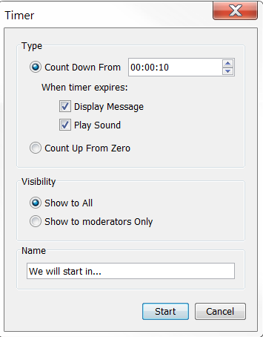
Timer

Slide 10
To your Practice Rooms
One person at a time
Set the Timer & try the different options

Slide 11
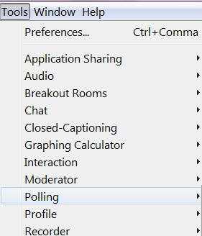
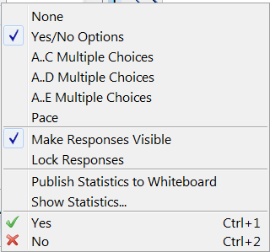
Poll Options

Slide 12
To your Practice Rooms
One person create a Poll
Everyone respond to the Poll

Slide 13
Create a Poll
One person create a poll about this image.
Everyone else respond to the poll!

Slide 14
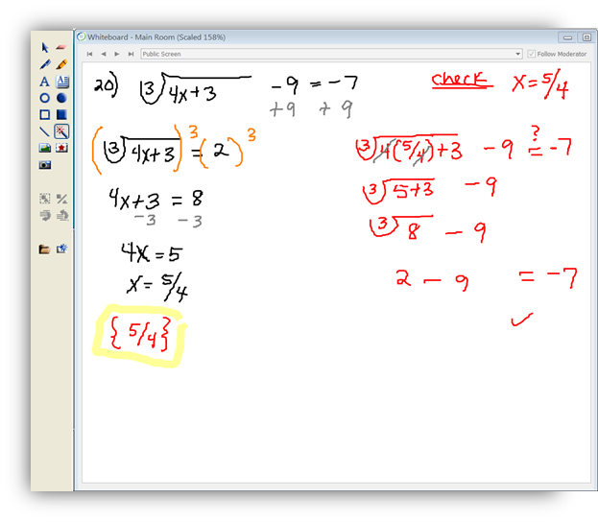
Whiteboard Tools
Select - Deselect
Eraser
Pen
Highlighter
Text – continuous
Text – defined area
Open ellipses
Closed ellipses
Straight Line
Pointer options
Import images
Clip art
Screen capture
Import PowerPoint or Image Files
Insert a blank screen

Slide 15
To your Practice Rooms
Everyone: Use the Text Tool to enter your name in box that fits you!

Slide 16
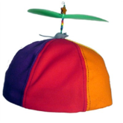
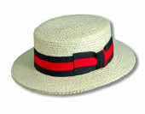

Slide 17
Load Files
PowerPoint and Open Office slides
Image Files *.bmp, *.gif, *.jpg, *.jpeg, *.png, and *.tif
10 MB maximum
Close files to start
Click on the Whiteboard Toolbar
Keep all default settings and follow the prompts…

Slide 18
To your Practice Rooms
One person at a time, Load the PPT file “Housekeeping Slides”

Slide 19
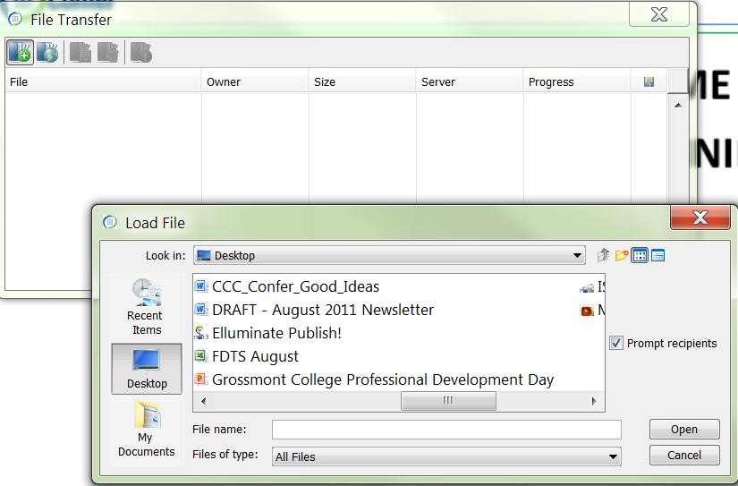
File Transfer

Slide 20
To your Practice Rooms
One person at a time, File Transfer “ CCC Confer Good Ideas”

Slide 21
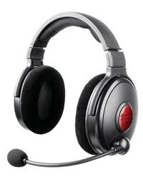
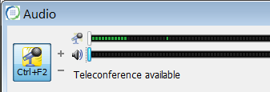
VOIP Communication

Slide 22
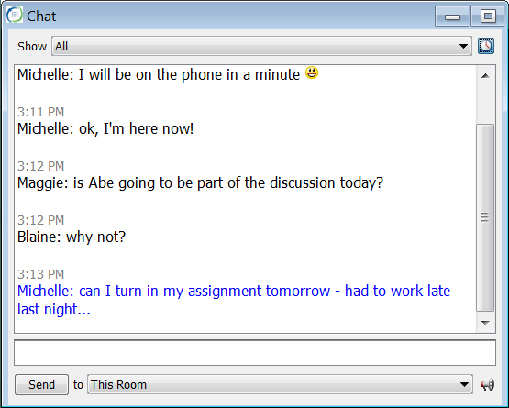
Text Chat
Public message
Private message
Enter your message and click Send
Private Chat selection

Slide 23
Application Sharing
Open and maximize applications before launching.

Slide 24
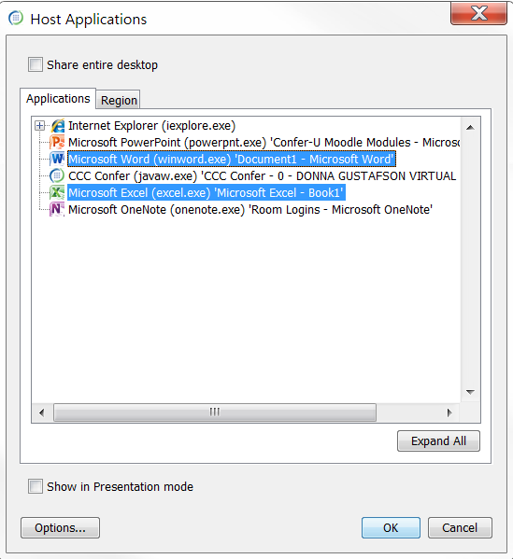
Choose Your Applications
DO NOT
check the box!

Slide 25
To your Practice Rooms
One person at a time - AppShare a file that resides on the desktop

Slide 26
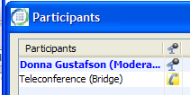
Record: Step 1
Record conversation and content.
Connect the Teleconference Bridge .

Slide 27
Record Step 2:
Start recording when ready.
Start recorder / Resume recording
Pause recording / Stop recording
* Everyone must exit the room for the recording package to complete and the archive to be available.

Slide 28
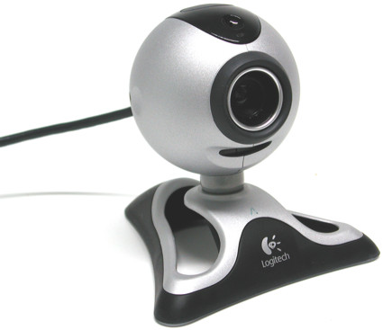
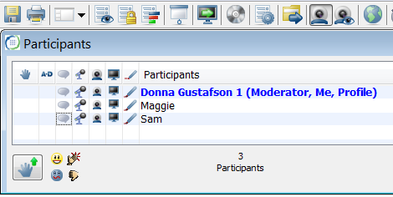
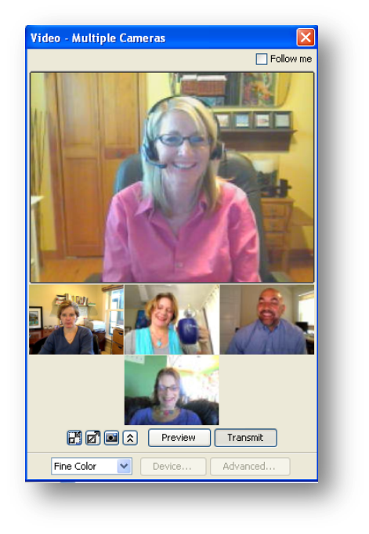
Webcam

Slide 29
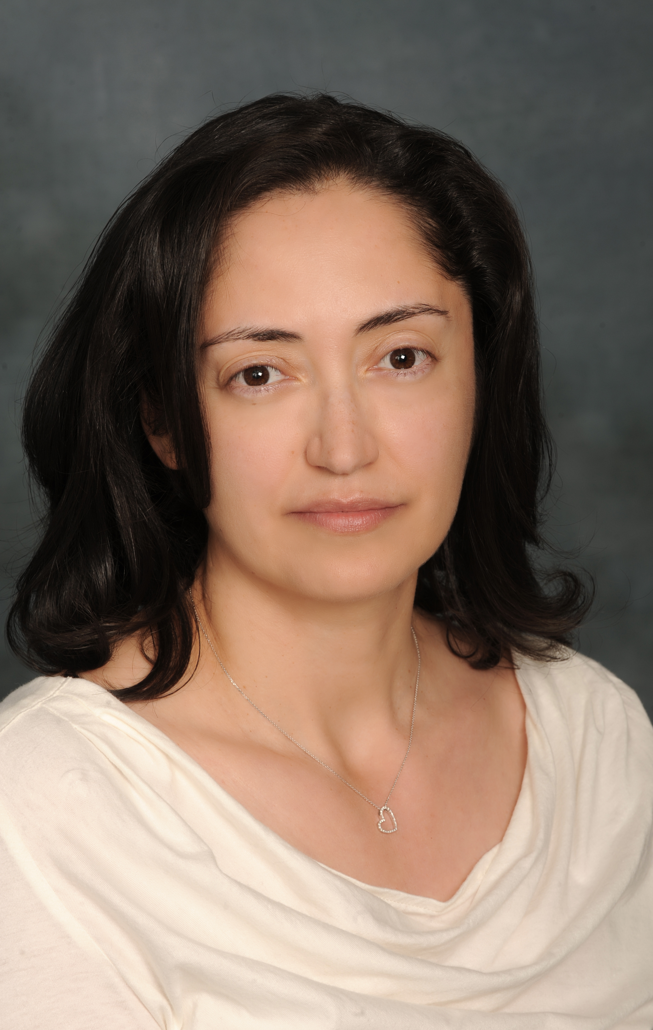
…and now Irene!

